Slide 1
Lesson 7: Functions
By: Ryan Alterman
Revised: 9-19-18

Slide 2
What are functions?
These are sections of code that are written to perform certain tasks.
C++ already has some functions created
But we can make our own as well; for specific uses
There are three parts to making a function:
Declaration
Definition
Call
It follows a general format:
Return_type identifier( parameters)
{
Body
}

Slide 3
Function Definition
This where the function is said to exist with these properties
Return_type
Some functions return values, and this is where we specify what it returns. If it returns nothing, it is void.
Identifier
It is the name of the function. It must start with a capital(part of coding standard)
Body
This is what says what the function does.
Parameters
They are the variables that the user inputs.
return_type identifier( parameters )
{
Body
}

Slide 4
Function Declaration
This is simply telling the compiler that a function exists
THIS IS NOT WHERE YOU DEFINE A FUNCTION(more on why later)
This simply looks like:
Return_type identifier( parameters);
The parameters do not actually require the variables during declaration
SO putting the variable type is fine

Slide 5
Function Call
This is where the function is actually used
This can look like
Variable = function();
When a function is called, control over the program is transferred to the function until the function returns a value or reaches its ending brace
You can call a function as many times as you want

Slide 6
Formating your project
There is a certain way we have to write these functions:
Function calls occur in the main source file
Function Definition occurs in a separate source file
Function Declaration occurs in a header file

Slide 7
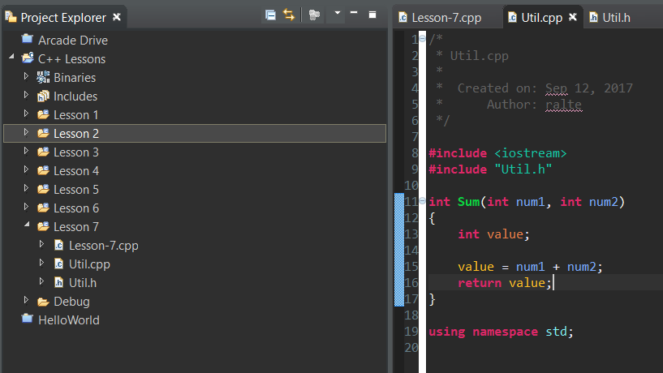
Function Definition

Slide 8
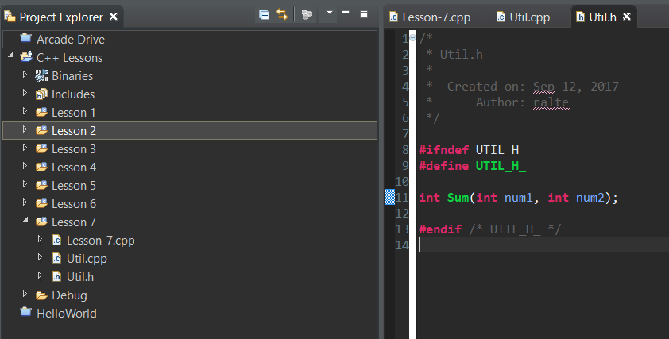
Function Declaration

Slide 9
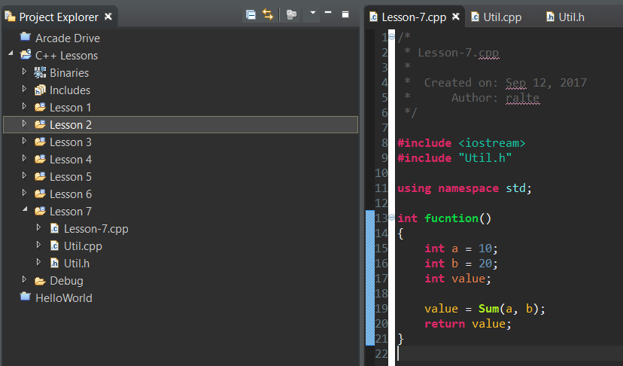
Function Call

Slide 10
Challenge
I want you to split into groups of at least 2. From now on I will be having you guys write robot projects. Today we are going to start simple by having you make code to move a motor on the input of a controller. I also want you to use a function in order to limit motor power. THIS WILL BE DIFFICULT; so pair with someone you can work well with. This will require you to use everything that you have learned.

Slide 11
Next: Advanced Numerics and Arrays

